Slide 1
Data Flow Diagram (DFD)

Slide 2

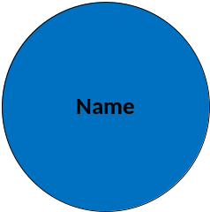
DFD Notations:
1. External entity
2. Process
3. Data flow
4. Data store

Slide 3



1. External Entity:
“A producer or consumer of data at outside of system.”
Examples: a person, a device, a system, organization etc.

Slide 4
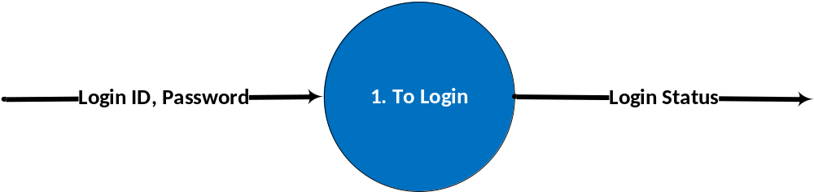
2. Process:
“It is a function inside system which takes input/s and do some work on input/s and produces some intended out put/s.”
Examples: To login, to select item, to generate invoice, to generate report etc.

Slide 5
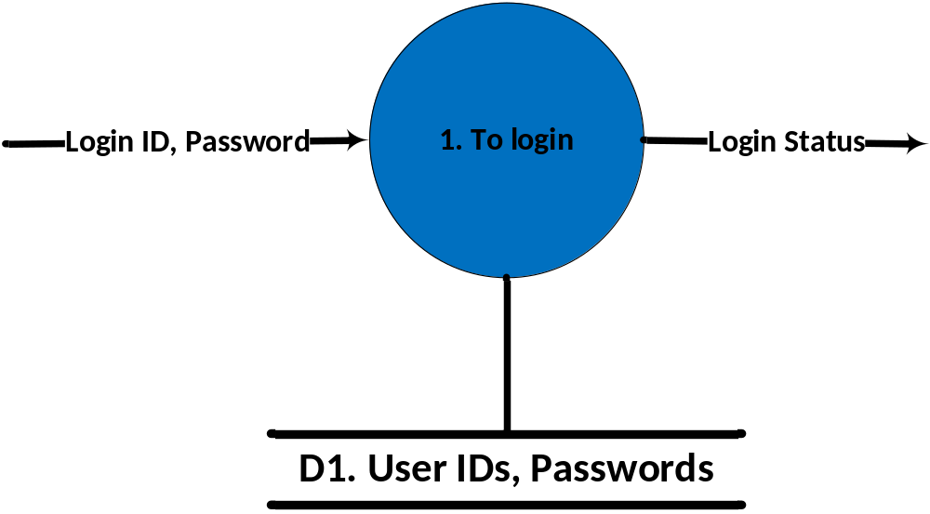
3. Data Store:
“It is a container which stores data permanently inside the system”.
Examples: Student data in CMS, Subjects data in CMS, User data for user management etc.

Slide 6
4. Data Flow:
“It shows the direction of flow of data”.

Slide 7
Example: “Physician Billing System”:
In the physician billing system, a physician examines a patient and inserts records into system about patient examination. This examination is verified and a valid fee is computed for patient. As the patient is availing the insurance, so he submits an insurance form, which holds all the detail about his insurance policy. It also describes that what amount will be paid by insurance company and what will be paid by the patient. Insurance details inserted are verified by the system. Based on valid fee and insurance form submitted, invoices for patient and insurance company are generated and are sent. Patient and insurance company make payments, which are verified by the system.

Slide 8
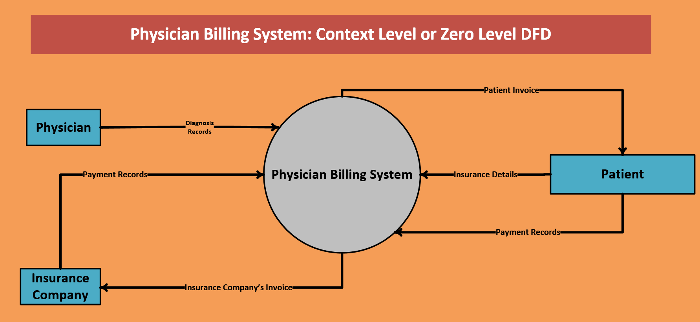

Slide 9
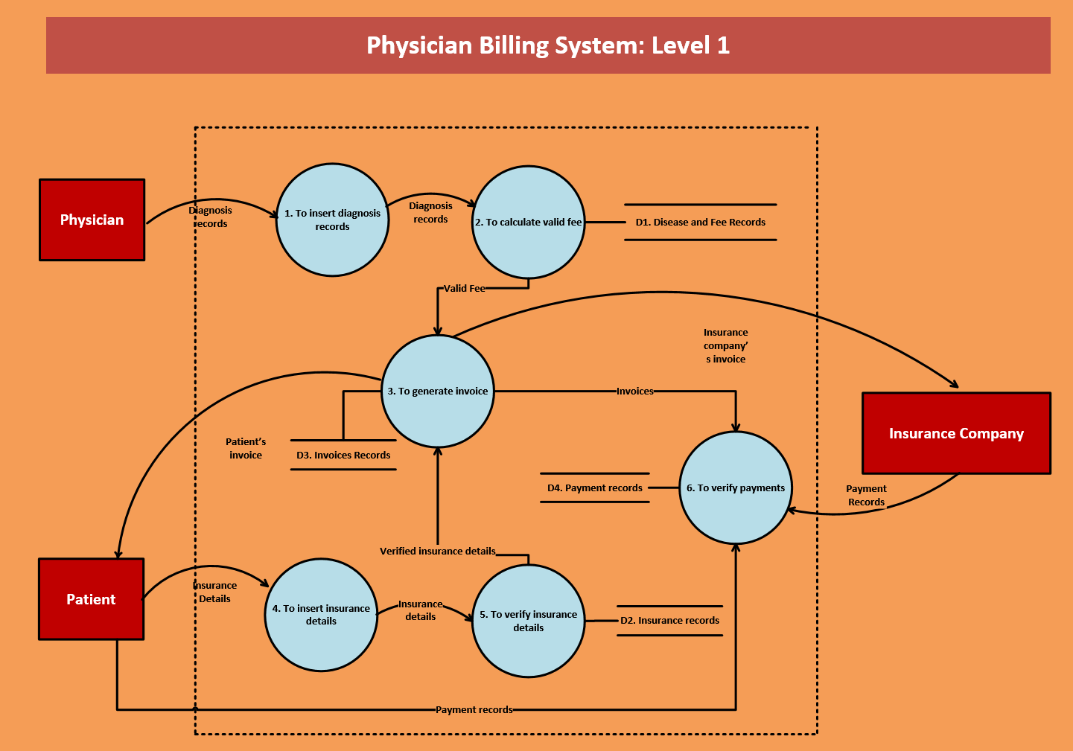

Slide 10
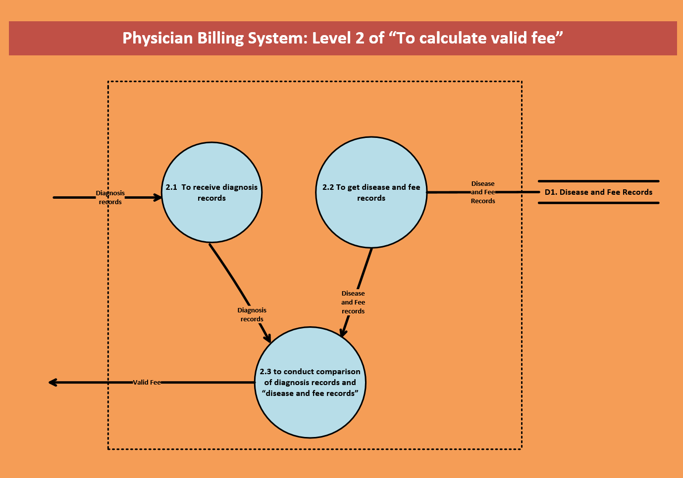

Slide 11
Guidelines for DFD
Every diagram and element has a name.
Process bubbles are labeled with verb phrases (except sometimes on the context diagram).
Data flows, data stores and external entities are named with descriptive noun phrases.
Every process bubble and every data store should be numbered.
When process bubbles are exploded, use decimal numbering to indicate related detailed processes
Avoid duplication of identical entities and data stores on the same diagram page.
Avoid crossing data flow lines.
Keep external entities near the outer edges of the diagram.
Use a top down approach when developing a set of DFDs.
All data flows either originate or terminate at a process bubble.
Diagrams should be balanced. Every flow shown going into or out of a process bubble, should also appear on its lower level diagram.
Redraw diagrams and re-label symbols as needed for clarity.

Slide 12
Case study for practice:
String Conversion System:
In a string conversion system, a user will give string/s. String/s will be validated. If string is not validated, user will insert the string again. Then user will insert an operator from followings:
Reverse String
Count Character of string
Concatenation of two strings
After that system will perform desired function and result will be shown to user.
Make context level and level 1 DFD of above case study?

